Slide 1
FINAL PROJECT · VIBE CODING CEDIA 2026
Competencies and Relevance: Mechatronics Engineering
Bilingual surveys supporting a new degree program before the CES
Américo Cruz (UTE) · José Raúl Castro (UTPL)
Project guide 04
Narration generated with an AI voice (ElevenLabs) and reviewed by the authors.
Vibe Coding CEDIA 2026 · Universidad UTE · UTPL
1 / 10
Notes:
COVER
NARRATION · ≈15 s · 30–40 words in English
Introduce the tool by name, say who is in the subgroup and which universities, and in one sentence what it solves.
Competencies and relevance of Mechatronics Engineering. We are Américo Cruz, from U T E, and José Raúl Castro, from U T P L. We present two bilingual surveys that help support the case for this new degree program.

Slide 2
FINAL PROJECT · VIBE CODING CEDIA 2026
The problem
Which skills does industry need? Interested students?
A CONCRETE EXAMPLE
“Automation” does not separate robotics from maintenance in Loja, Zamora and El Oro
Vibe Coding CEDIA 2026 · Universidad UTE · UTPL
2 / 10
Notes:
PART A · PRESENTATION (3 min in total)
THE PROBLEM · NARRATION · ≈35 s · 80–90 words
Describe the real task, who struggles with it and what it costs today. A concrete example beats a general figure.
To open a Mechatronics Engineering program, a university must justify its relevance. It reports to the C E S, the national higher education council. It needs to know whether industry requires these skills. It also needs to know whether students are interested. A general question about automation does not reveal what companies in Loja, Zamora Chinchipe and El Oro need. On top of that, surveys scored by hand have typical errors. A blank is counted as zero, or a reversed question is forgotten.

Slide 3
FINAL PROJECT · VIBE CODING CEDIA 2026
The tool
WHO USES IT
WHAT GOES IN
WHAT COMES OUT
Program design team
Answers from 1 to 5
Average and CSV
Vibe Coding CEDIA 2026 · Universidad UTE · UTPL
3 / 10
Notes:
THE TOOL · NARRATION · ≈30 s · 70–80 words
Who uses it, what goes in and what comes out. Name the project guide it builds on.
We built two web forms based on guide four of the course. They are used by the team designing the proposal for the new program. One form is for industry technicians and the other is for prospective students. Each has ten questions, in Spanish or in English. They open in a web browser from a single link, and nothing needs to be installed. The respondent sees a result instantly and gives no personal data.

Slide 4
FINAL PROJECT · VIBE CODING CEDIA 2026
How it works
1 · INPUT
2 · AI
3 · REVIEW
4 · RESULT
Team defines competencies
Drafts and programs
Team approves
Form and CSV
A person decides
Vibe Coding CEDIA 2026 · Universidad UTE · UTPL
4 / 10
Notes:
HOW IT WORKS · NARRATION · ≈40 s · 95–105 words
Walk through the four steps. Make clear what the AI does and what a person always decides.
Each question is a statement on a scale from one to five. Question ten is reversed, so its score is six minus the answer. The average is calculated only with eight or more answers. With fewer, the form says insufficient answers. A blank is never counted as zero. A I helped us draft the questions and write the code for the calculation, step by step. The team reviewed and approved every question. This keeps the results comparable between respondents. A person always decides who is invited and how the results are interpreted. Those choices shape the conclusions.

Slide 5
FINAL PROJECT · VIBE CODING CEDIA 2026
Evidence that it works
16/16
0
35/35
correct cases
differences in 420 records
incomplete records excluded
Simulated data: they test the calculation, not demand.
Vibe Coding CEDIA 2026 · Universidad UTE · UTPL
5 / 10
Notes:
EVIDENCE · NARRATION · ≈35 s · 80–90 words
Figures from your own tests. Separate what was checked from what is still a proposal.
We ran three tests. Four reference cases, in two surveys and two languages, gave sixteen out of sixteen correct results. Then we passed four hundred and twenty simulated records through the real form. The simulated data included blanks and dropouts. Compared with an independent calculation in Python, there were zero differences. The form left all thirty five incomplete records out of the average. These figures show that the calculation works. They do not show that the demand is real, and we say so clearly.

Slide 6
FINAL PROJECT · VIBE CODING CEDIA 2026
Limits and responsible use
WHAT IT DOES NOT DO
DATA AND PRIVACY
NEXT STEP
No fieldwork or analysis
Anonymous except email
Consent and pilot
Vibe Coding CEDIA 2026 · Universidad UTE · UTPL
6 / 10
Notes:
LIMITS AND RESPONSIBLE USE · NARRATION · ≈25 s · 55–65 words
What it does not do, how it protects data and the next step (Moodle or another LMS, or the next AI-native level).
The tool does not run the survey and does not analyze real responses. It does not replace expert validation or a pilot study. The form is anonymous and calculates in the browser. But the email button reveals the sender. Before using it with real people, we still need informed consent. We also need a review of the English version and testing on phones.

Slide 7
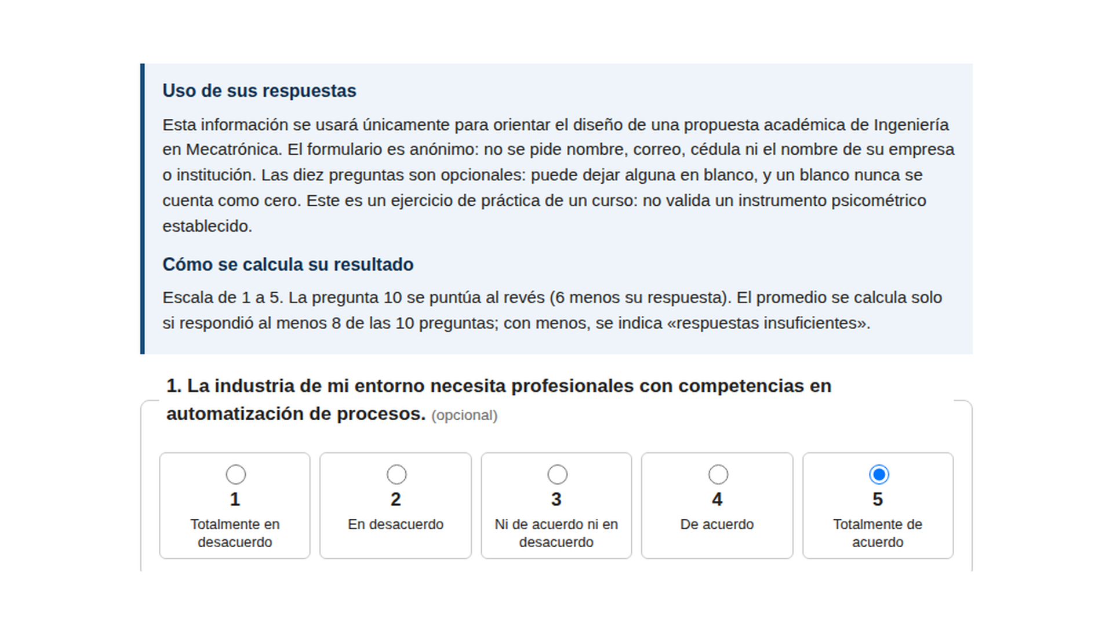
FINAL PROJECT · VIBE CODING CEDIA 2026
Demo · Input
Technician survey: anonymity notice and a 1 to 5 scale
Vibe Coding CEDIA 2026 · Universidad UTE · UTPL
7 / 10
Notes:
PART B · DEMO (2 min in total)
NARRATION · ≈30 s · 70–80 words in English
Show the start or input screen. Say what the person enters and why.
We open the link to the survey for industry technicians and choose Spanish. At the top is the notice on how answers are used. It says the form is anonymous and that every question is optional. It also explains how the result is calculated. Each statement is answered on the scale from one to five. On question ten we answer one, because disagreeing with that statement supports the new program.

Slide 8
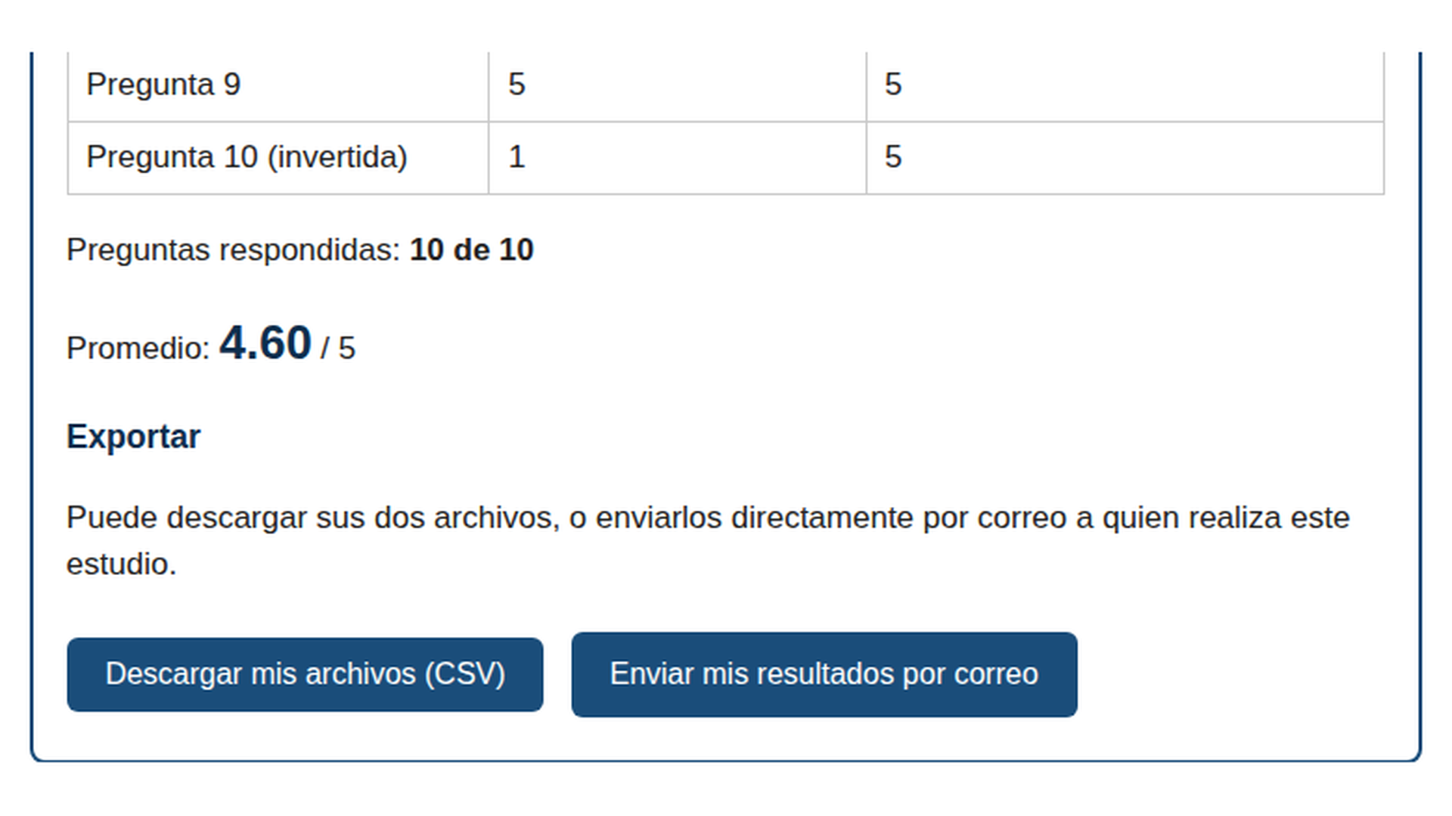
FINAL PROJECT · VIBE CODING CEDIA 2026
Demo · Result
Question 10 reversed: 1 becomes 5 · Average 4.60
Vibe Coding CEDIA 2026 · Universidad UTE · UTPL
8 / 10
Notes:
NARRATION · ≈35 s · 80–90 words in English
Show the main result. Point to where to look on the screenshot and what it means.
We press the button see my result. The table shows each original answer and its transformed score. The one on question ten becomes a five. This confirms that the reversal is applied once, and to the right item. Below the table we see ten out of ten questions answered. The average is four point six zero, the same as the reference calculation. With fewer than eight answers, the form does not calculate an average and shows a notice instead. So nobody reads a misleading number.

Slide 9
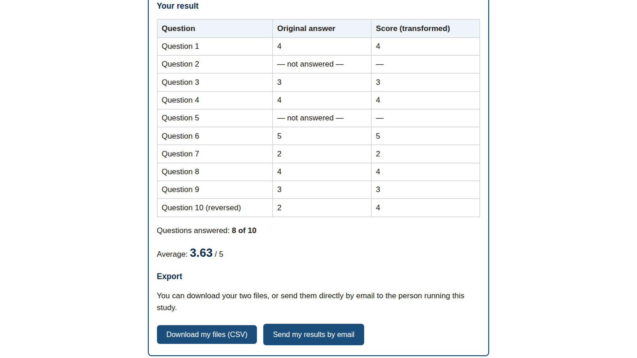
FINAL PROJECT · VIBE CODING CEDIA 2026
Demo · Review and delivery
In English: blanks never count as zero · CSV export
Vibe Coding CEDIA 2026 · Universidad UTE · UTPL
9 / 10
Notes:
NARRATION · ≈30 s · 70–80 words in English
Show where the person reviews, approves or exports. Close the demo with the test that backs it.
Now we see the student survey in English. This time we leave two questions blank. The table marks them as not answered and does not count them as zero. This shows that the same rules apply in both languages. With eight out of ten answers, the average is three point six three. At the end, the respondent downloads two C S V files. They can also send them by email, although that reveals their address.

Slide 10
FINAL PROJECT · VIBE CODING CEDIA 2026
Two surveys ready to hear from industry
Next step: consent and real responses
jrcastro1967.github.io/encuestas-mecatronica
Américo Cruz (UTE) · José Raúl Castro (UTPL)
Vibe Coding CEDIA 2026 · Universidad UTE · UTPL
10 / 10
Notes:
CLOSE · NARRATION · ≈25 s · 55–65 words
What changes in the subgroup's work, the next step and a short invitation. End on a complete sentence.
We built two bilingual surveys that calculate correctly and are shared with a single link. The next step is the most important one. We will review the English, add a consent statement, and apply the surveys to real technicians and high school students. Other programs can adapt them by changing the questions. Thank you for your attention, and thank you to CEDIA for the course.

